Slide 1
Chapter 4 Arithmetic and Logic Instructions
4.1 Arithmetic Instructions
4.2 Signed Number Concepts
4.3. Logic Instructions
4.4 BCD and ASCII Conversion
4.5 Parameter Passing

Slide 2
Chapter 4 Arithmetic and Logic Instructions
4.1 Arithmetic Instructions
4.2 Signed Number Concepts
4.3. Logic Instructions
4.4 BCD and ASCII Conversion
4.5 Parameter Passing

Slide 3
Addition
ADDLW K ; WREG = WREG + K
ADDWF fileReg,D,A ;result=WREG+fileReg
ADDWFC fileReg,D,A;result=WREG+carry+fileReg
Example:
MOVLW 0xF5
ADDLW 0xB5
WREG = 00
N=1, OV=0, Z=0 DC=0, C=1

Slide 4
Example
Assume that RAM locations 40-43 have the following values.
Write a program to find the sum of the values All values are in hex.
40=(7D) 41=(EB) 42=(C5)
43=(5B)
Solution:
L_BYTE EQU 0x6
H_BYTE EQU 0x7
MOVLW 0
MOVWF H_BYTE
ADDWF 0x40, W
BNC N_1
INCF H_BYTE, F
Notes:
In the first iteration of the loop, 7DH is added to A with CY=0 and R7=00, and the counter R2=04.
In the second iteration of the loop, EBH is added to A with CY=1. Since a carry occurred, R7 is incremented. No the counter R2=03H, R7=1, A=68H.
C5H is added to A, which makes CY=1, A=2DH, R7=02H, R2=02H.
5BH is added to A, which makes CY=0, A=88H, R7=02H, R2=01H.
30H is added to A, which makes CY=1, A=B8H, R7=02H.
DJNZ R2, AGAIN, R2=00H and not jump to AGAIN

Slide 5
Example
N_1 ADDWF 0x41, W
BNC N_2
INCF H_BYTE, F
N_2 ADDWF 0x42, W
BNC N_3
INCF H_BYTE, F
N_3 ADDWF 0x43, W
BNC N_4
INCF H_BYTE, F
N_4 MOVWF L_BYTE
After adding four numbers, the result is
288H, where is it?
Notes:
In the first iteration of the loop, 7DH is added to A with CY=0 and R7=00, and the counter R2=04.
In the second iteration of the loop, EBH is added to A with CY=1. Since a carry occurred, R7 is incremented. No the counter R2=03H, R7=1, A=68H.
C5H is added to A, which makes CY=1, A=2DH, R7=02H, R2=02H.
5BH is added to A, which makes CY=0, A=88H, R7=02H, R2=01H.
30H is added to A, which makes CY=1, A=B8H, R7=02H.
DJNZ R2, AGAIN, R2=00H and not jump to AGAIN

Slide 6
Example
Write a program to add two 16-bit numbers. The numbers are 3CE7H and 3B8DH.
Assume 00=(8D), 01=(3B), 02=(E7), 03=(3C)
MOVF 0x00,W
ADDWF 0x02, F
MOVF 0x01,W
ADDWFC 0x03, F
The result is stored in locations 2 and 3.
Notes:
In the first iteration of the loop, 7DH is added to A with CY=0 and R7=00, and the counter R2=04.
In the second iteration of the loop, EBH is added to A with CY=1. Since a carry occurred, R7 is incremented. No the counter R2=03H, R7=1, A=68H.
C5H is added to A, which makes CY=1, A=2DH, R7=02H, R2=02H.
5BH is added to A, which makes CY=0, A=88H, R7=02H, R2=01H.
30H is added to A, which makes CY=1, A=B8H, R7=02H.
DJNZ R2, AGAIN, R2=00H and not jump to AGAIN

Slide 7
BCD Number System
Binary Coded Decimal : use binary to represent 0-9 only.
Two terms for BCD number:
Unpacked BCD
Packed BCD
Digit
BCD
0
0000
1
0001
2
0010
3
0011
4
0100
5
0101
6
0110
7
0111
8
1000
9
1001

Slide 8
Unpacked / Packed BCD Numbers
In Unpacked BCD, a byte is used to contain a BCD number.
0000 0101 is unpacked BCD for 5
0000 1001 is unpacked BCD for 9
In Packed BCD, a byte has two BCD numbers.
0101 1001 is packed BCD for 59.
It is twice as efficient in storing data.
When we get two BCD numbers, we want to add them directly in form of packed BCD.
However, ADDFW and ADDFWC are just for binary!

Slide 9
Addition of Packed BCD Numbers
Use ADD and ADDC to add two packed BCD numbers:
To calculate 17₁₀+18₁₀=35₁₀.
MOVLW 17H
ADDLW 18H
If the resulting lower order byte > 9 or there is a carry from bit3 to bit 4, the programmer must add 6 to the low digital, Then we get the correct packed BCD sum (35H).
1 7
+ 1 8
2 F
2 F
+ 0 6
3 5

Slide 10
DAW
Decimal adjust for addition
DAW instruction will add 6 to the lower nibble or higher nibble if needed.
MOVLW 0x00
ADDLW 0x47 4 7
ADDLW 0x55 + 5 5
DAW 9 C
A 2
;check CY here CY=1 0 2
1. Lower nibble
2. Upper nibble

Slide 11
Example
Assume that RAM locations 40-43 have the following packed BCD values. Write a program to find the sum of the values.
40=(34) 41=(21) 42=(99)
43=(88)
Solution:
L_BYTE EQU 0x6
H_BYTE EQU 0x7
MOVLW 0
MOVWF H_BYTE
ADDWF 0x40, W
DAW
BNC N_1
INCF H_BYTE, F
Notes:
In the first iteration of the loop, 7DH is added to A with CY=0 and R7=00, and the counter R2=04.
In the second iteration of the loop, EBH is added to A with CY=1. Since a carry occurred, R7 is incremented. No the counter R2=03H, R7=1, A=68H.
C5H is added to A, which makes CY=1, A=2DH, R7=02H, R2=02H.
5BH is added to A, which makes CY=0, A=88H, R7=02H, R2=01H.
30H is added to A, which makes CY=1, A=B8H, R7=02H.
DJNZ R2, AGAIN, R2=00H and not jump to AGAIN

Slide 12
Example
N_1 ADDWF 0x41, W
DAW
BNC N_2
INCF H_BYTE, F
N_2 ADDWF 0x42, W
DAW
BNC N_3
INCF H_BYTE, F
N_3 ADDWF 0x43, W
DAW
BNC N_4
INCF H_BYTE, F
N_4 MOVWF L_BYTE
Notes:
In the first iteration of the loop, 7DH is added to A with CY=0 and R7=00, and the counter R2=04.
In the second iteration of the loop, EBH is added to A with CY=1. Since a carry occurred, R7 is incremented. No the counter R2=03H, R7=1, A=68H.
C5H is added to A, which makes CY=1, A=2DH, R7=02H, R2=02H.
5BH is added to A, which makes CY=0, A=88H, R7=02H, R2=01H.
30H is added to A, which makes CY=1, A=B8H, R7=02H.
DJNZ R2, AGAIN, R2=00H and not jump to AGAIN

Slide 13
Subraction of unisgned numbers
Subtracter circuit is cumbersome. (Why?)
PIC performs the 2’s complement then uses adder circuit to the result.
There are four sub instructions
SUBLW k (k – WREG)
SUBWF f d a ( destination = fileReg – WREG)
SUBWFB f d a ( destination = fileReg – WREG-borrow)
SUBFWB f,d,a (destination = WREG-fileReg-borrow)
C=1, no borrow
C=0, borrow

Slide 14
Example
Examine
MOVLW 0x23
SUBLW 0x3F
Solution:
K=3F=0011 1111
Internal it do :
W=23=0010 0011→2’s→ 1101 1101
0011 1111 + 1101 1101 = 1 0001 1100
C=1
Notes:
In the first iteration of the loop, 7DH is added to A with CY=0 and R7=00, and the counter R2=04.
In the second iteration of the loop, EBH is added to A with CY=1. Since a carry occurred, R7 is incremented. No the counter R2=03H, R7=1, A=68H.
C5H is added to A, which makes CY=1, A=2DH, R7=02H, R2=02H.
5BH is added to A, which makes CY=0, A=88H, R7=02H, R2=01H.
30H is added to A, which makes CY=1, A=B8H, R7=02H.
DJNZ R2, AGAIN, R2=00H and not jump to AGAIN

Slide 15
Example
Write a program to subtract 4C-6E.
MYREG EQU 0x20
MOVLW 0x4C
MOVWF MYREG
MOVLW 0x6E
SUBWF MYREG, W
Note that we can check N flag (C flag) to determine if the result is negative or not.
In sum, for unsigned number, check C
for signed, check N
Notes:
In the first iteration of the loop, 7DH is added to A with CY=0 and R7=00, and the counter R2=04.
In the second iteration of the loop, EBH is added to A with CY=1. Since a carry occurred, R7 is incremented. No the counter R2=03H, R7=1, A=68H.
C5H is added to A, which makes CY=1, A=2DH, R7=02H, R2=02H.
5BH is added to A, which makes CY=0, A=88H, R7=02H, R2=01H.
30H is added to A, which makes CY=1, A=B8H, R7=02H.
DJNZ R2, AGAIN, R2=00H and not jump to AGAIN

Slide 16
Example
Write a program to subtract two 16 bit numbers (2762H-1296H)
Assume location 6 = (62), location 7=(27)
MOVLW 0x96
SUBWF 0x6, F ; F=F-W=62-96=CCH, C=0,N=1
MOVLW 12
SUBWFB 0x7,F ;F=F-W-b=27-12-1=14H
Note that we can check N flag (C flag) to determine if the result is negative or not.
Notes:
In the first iteration of the loop, 7DH is added to A with CY=0 and R7=00, and the counter R2=04.
In the second iteration of the loop, EBH is added to A with CY=1. Since a carry occurred, R7 is incremented. No the counter R2=03H, R7=1, A=68H.
C5H is added to A, which makes CY=1, A=2DH, R7=02H, R2=02H.
5BH is added to A, which makes CY=0, A=88H, R7=02H, R2=01H.
30H is added to A, which makes CY=1, A=B8H, R7=02H.
DJNZ R2, AGAIN, R2=00H and not jump to AGAIN

Slide 17
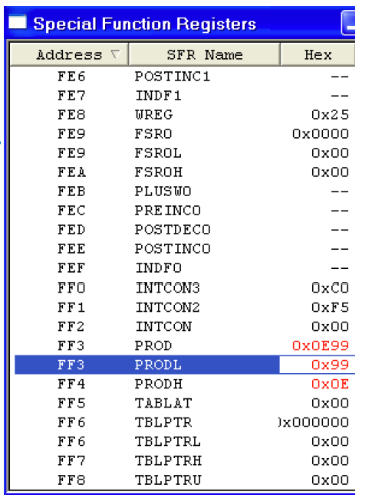
Multiplication of unsigned number
PIC supports byte-by-byte multiplication
One of the operand must be in WREG
After multiplication, the result is stored in PRODH and PRODL (16 bit)
Example
MOVLW 0x25
MULLW 0x65
Notes:
Multiplication of operands larger than 8-bit takes some manipulation. Programmer need to multiple byte by byte and sum them together.

Slide 18
Division of unsigned numbers
There is no single instruction for the division of byte/byte numbers
We need to write a program
Repeated subtraction.
The numerator is placed in a fileReg.
The quotient is the number of times we subtracted.
The reminder is in fileReg upon completion.
Notes:
Multiplication of operands larger than 8-bit takes some manipulation. Programmer need to multiple byte by byte and sum them together.

Slide 19
Example
Convert the hexadecimal number FDH stored in location 0x15H, into deciaml. Save the digits in locations 0x22,0x23,0x24.
NUME EQU 0x15
QU EQU 0x20
RMND_L EQU 0X22
RMND_M EQU 0x23
RMND_H EQU 0x24
MYNUM EQU 0xFD
MYDEN EQU D’10’
Org 0H
MOVLW MYNUM
MOVWF NUME
MOVLW MYDEN
CLRF QU
D_1 INCF QU,F
SUBWF NUME
BC D_1
Notes:
In the first iteration of the loop, 7DH is added to A with CY=0 and R7=00, and the counter R2=04.
In the second iteration of the loop, EBH is added to A with CY=1. Since a carry occurred, R7 is incremented. No the counter R2=03H, R7=1, A=68H.
C5H is added to A, which makes CY=1, A=2DH, R7=02H, R2=02H.
5BH is added to A, which makes CY=0, A=88H, R7=02H, R2=01H.
30H is added to A, which makes CY=1, A=B8H, R7=02H.
DJNZ R2, AGAIN, R2=00H and not jump to AGAIN

Slide 20
Example
ADDWF NUME
DECF QU, F
MOVFF NUME RMND_L
MOVFF QU, NUME
CLRF QU
D_2 INCF QU,F
SUBWF NUME
BC D_2
ADDWF NUME
DECF QU, F
MOVFF NUME, RMND_M
MOVFF QU, RMND_H
Notes:
In the first iteration of the loop, 7DH is added to A with CY=0 and R7=00, and the counter R2=04.
In the second iteration of the loop, EBH is added to A with CY=1. Since a carry occurred, R7 is incremented. No the counter R2=03H, R7=1, A=68H.
C5H is added to A, which makes CY=1, A=2DH, R7=02H, R2=02H.
5BH is added to A, which makes CY=0, A=88H, R7=02H, R2=01H.
30H is added to A, which makes CY=1, A=B8H, R7=02H.
DJNZ R2, AGAIN, R2=00H and not jump to AGAIN

Slide 21
Chapter 4 Arithmetic and Logic Instructions
4.1 Arithmetic Instructions
4.2 Signed Number Concepts
4.3. Logic Instructions
4.4 BCD and ASCII Conversion
4.5 Parameter Passing

Slide 22
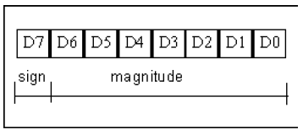
Signed Number Concepts and Arithmetic Operations
The MSB is set aside for the sign (0 or -)
The rest, 7 bits, are used for the magnitude.
To convert any 7-bit positive number to negative use the 2’s complement
You have 128 negative numbers and 127 positive numbers

Slide 23
Computer: Signed Binary Number
Arithmetic Operations with 2’s Complement Number System
Overflow Condition
When two signed numbers are added and the number of bits required to represent the sum exceeds the number of bits in the two numbers, an overflow result is indicated by an incorrect sign bit.
An overflow can occur only when both numbers are positive or negative. 128+58
01111101
+ 00111010
----------------------------
10110111
From the binary calculation, +ve + +ve = -ve => impossible =>
Overflow.
Check sign bits.
23
Notes:
2023/2/14
A printer is an example of embedded system since the processor inside it performs one task only.

Slide 24
Example
Show how the PIC18 would represent –128.
Solution:
Observe the following steps.
1000 0000 128 in 8-bit binary 80H
0111 1111 invert each bit
1000 0000 add 1 (which becomes 80 in hex)
Therefore -128 = 80H, the signed number representation in 2’s
complement for -128.
We can get FBH=100H-80H=FBH, too.

Slide 25
Overflow Problem
The CPU understands only 0s and 1s and ignores the human convention of positive and negative numbers.
The overflow flag (OV) is designed to indicate an overflow of the operations for the signed numbers.
The accept range –128 to 127 in decimal.
When is an overflow?
If the result of an operation on signed numbers is too large for the 8-bit register, an overflow has occurred and the programmer must be notified.

Slide 26
Example
Examine the following code and analyze the result.
MOVLW +D’96’
ADDLW +D’70’
Solution:
96 0110 0000
+ 70 0100 0110
+ 166 1010 0110 (CY=0, OV=1)
The signed value in the register A=A6H=-90 is wrong. Programmer must check it (check OV) by themselves.
The above checking is done by computer. Actually, the CPU can check the sign bits. See if the sign bits are agree with our expectation or not.
Notes:
Simlab_8051 does not know #+96 and #-128.

Slide 27
When is an Overflow?
In 8-bit signed number operations, OV is set to 1 if either of the following conditions occurs:
The resulting sign bit is wrong.

Slide 28
Example
Observe the following, noting the role of the OV flag.
MOVLW -D’128’
ADDLW –D’2’
Solution:
-128 1000 0000
+ -2 1111 1110
- 130 0111 1110 (CY=1,OV=1,N=0)
The sign bit is wrong so the hardware set OV=1.

Slide 29
Example
Examine the following, noting the role of OV.
MOVLW +D’7’
ADDLW +D’25’
Solution:
7 0000 0111
+ 18 0001 0010
25 0001 1001 (CY=0,OV=0,N=0)
+ve + +ve , the resulting sign bit is 0 (+ve), the sign bit is correct.
The hardware reset OV=0.

Slide 30
Chapter 4 Arithmetic and Logic Instructions
4.1 Arithmetic Instructions
4.2 Signed Number Concepts
4.3. Logic Instructions
4.4 BCD and ASCII Conversion
4.5 Parameter Passing

Slide 31
Logic Instructions
Widely used instructions
ANDLW k
ANDFW FileReg, d
IORLW k
IORFW FileReg, d
XORLW k
XORFW FileReg, d
Affect only Z and N Flags

Slide 32
Complement Instructions
COMF FileReg,d
Takes the 1’s complement of a file register
Affect only Z and N Flags
NEGF FileReg
Takes the 2’s complement of a file register
Affect all Flags
Example
MYREG EQU 0x10
MOVLW 0x85
MOVWF MYREG
NEGF MYREG

Slide 33
Compare Instructions
These instructions take 1 or 2 MCs
CPFSGT fileReg | Compare FileReg with WREG, skip if greater than | fileReg > WREG
CPFSEQ fileReg | Compare FileReg with WREG, skip if equal | fileReg = WREG
CPFSLT fileReg | Compare FileReg with WREG, skip if less than | fileReg < WREG

Slide 34
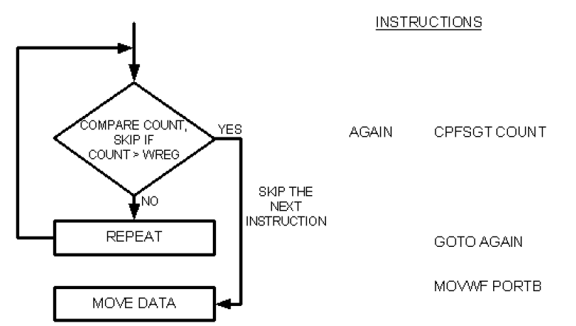
Flowchart for CPFSGT

Slide 35
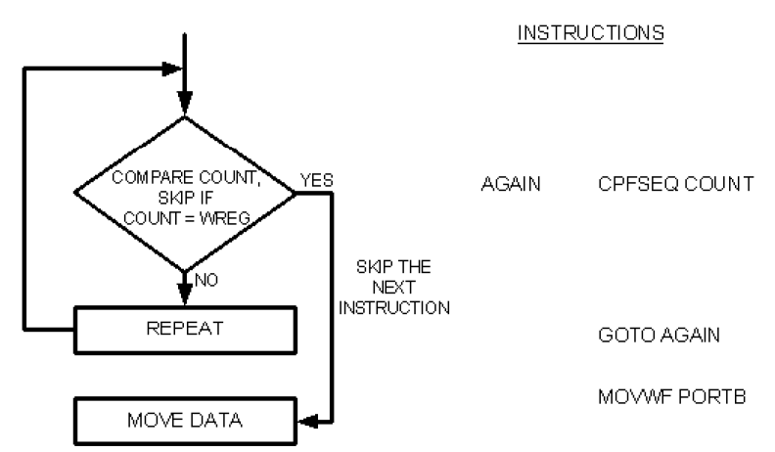
Flowchart for CPFSEQ

Slide 36

Flowchart for CPFSLT

Slide 37
Write code to determine if data on PORTB contains the value 99H.
If so, write letter ‘y’ to PORTC. Otherwise, make PORTC=‘N’
CLRF TRISC
MOVLW A’N’
MOVWF PORTC
SETF TRISB
MOVLW 0x99
CPFSEQ PORTB
BRA OVER
MOVLW A’y’
MOVWF PORTC
OVER: … … …

Slide 38
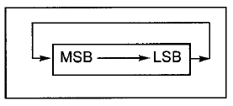
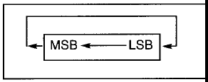
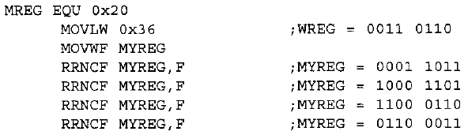
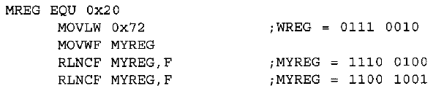
Rotate instruction
Rotate fileReg Right or Left (no Carry)
RRNCF fileRed, d
RLNCF fileRed, d
affect the N and Z flag
rotate right rotate left

Slide 39
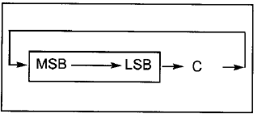
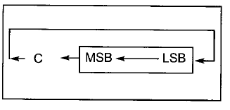
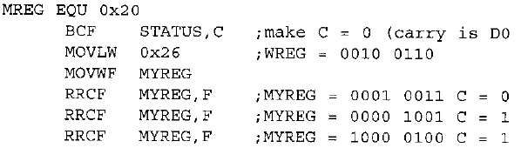
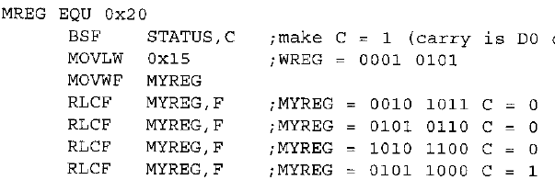
Rotate instruction
Rotate Right or Left through Carry flag
RRCF fileRed, d
RLCF fileRed, d
affect the C, N and Z flag
rotate right rotate left

Slide 40
Example
Write code to find the number of 1’s in a given number 97H
R1 EQU 0x20; fileREG for number of 1’s
COUNT EQU 0x21; fileREG for counter
VALREG EQU 0x22; fileREG for the byte
BCF STATUS, C; C=0
CLRF R1
MOVLW 0x8 ; load the counter
MOVWF COUNT
MOVLW 0x97
MOVWF VALREG
AGAIN RLCF VALREG, F
BNC NEXT
INCF R1
NEXT DECF COUNT, F
BNZ AGAIN

Slide 41
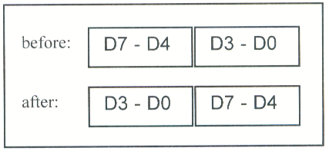
SWAP
SWAPF fileREG, d
swap the lower nibble and the higher nibble
In the absence of a SWAPF instruction,
how would you exchange the nibbles? How
many rotate instruction do you need?

Slide 42
Chapter 4 Arithmetic and Logic Instructions
4.1 Arithmetic Instructions
4.2 Signed Number Concepts
4.3. Logic Instructions
4.4 BCD and ASCII Conversion
4.5 Parameter Passing

Slide 43
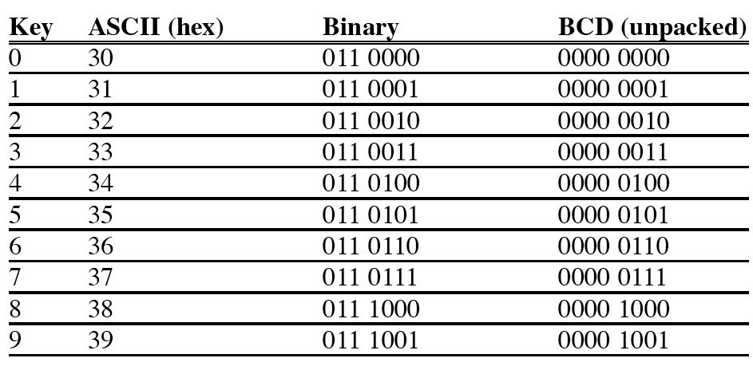
BCD and ASCII

Slide 44
Packed BCD and ASCII Conversion
Packed BCD to ASCII
Packed BCD unpacked BCD ASCII
29H 02H & 09H 32H & 39H
0010 1001 0000 0010 & 0000 1001 0011 0010 & 0011 1001
Packed BCD to ASCII
key ASCII unpacked BCD packed BCD
"4" 34H 0000 0100 0100 0111
"7" 37H 0000 0111

Slide 45
Example
Assume that register WREG has packed BCD. Write a program to convert it to two ASCII numbers and place the them in file register locations 6 and 7.
BCD_VAL EQU 0x29
L_ASC EQU 0x06
H_ASC EQU 0x07
MOVLW BCD_VAL ;load the BCD value
ANDLW 0x0F ;mask the upper 4 bits
IORLW 0x30 ;make it an ASCII, W=39H
MOVWF L_ASC ;Save LSD ASCII
MOVLW BCD_VAL ;get the BCD value
ANDLW 0xF0 ;mask the lower 4 bits
SWAPF WREG, W ;swap the nibbles
IORLW 0x30 ;make it an ASCII, W=32H
MOVWF H_ASC ;save MSD ASCII

Slide 46
Example
Write a program to convert two digit ASCII numbers (47) to a packed BCD.
MYBCD EQU 0x29
MOVLW A’4’
ANDLW 0x0F ;mask the upper 4 bits
MOVWF MYBCD
SWAPF MYBCD, F
MOVLW A’7’
ANDLW 0x0F
IORWF MYBCD, F

Slide 47
Chapter 4 Arithmetic and Logic Instructions
4.1 Arithmetic Instructions
4.2 Signed Number Concepts
4.3. Logic Instructions
4.4 BCD and ASCII Conversion
4.5 Parameter Passing

Slide 48
Parameter passing
Passing parameters to and from a subroutine
Subroutines that process a different set of data each time they are called – communications required.
Examples:
A routine that calculates convert two BCD digits (ASCII format)
A packed BCD.
In high level language, we have
Pass by value - variables are referred to directly
Pass by address (pointer) – a pointer to a value or a pointer to a data structure is passed.

Slide 49
Parameter passing by value (use fixed file register locations)
Registers
advantage: fast,
disadvantages: limited numbers of parameters
ascii_l EQU 0x0
ascii_h EQU 0x1
out_bcd EQU 0x2
local_var EQU 0x3
ORG 0
MOVLW A'4'
MOVWF ascii_h
MOVLW A'7'
MOVWF ascii_l
CALL ASCTOBCD
MOVLW A'3'
MOVWF ascii_h
MOVLW A'9'
MOVWF ascii_l
CALL ASCTOBCD
here goto here
ASCTOBCD:
MOVF ascii_h,W
ANDLW 0x0F
MOVWF local_var
SWAPF local_var, F
MOVF ascii_l,W
ANDLW 0x0F
IORWF local_var, F
MOVFF local_var, out_bcd
return

Slide 50
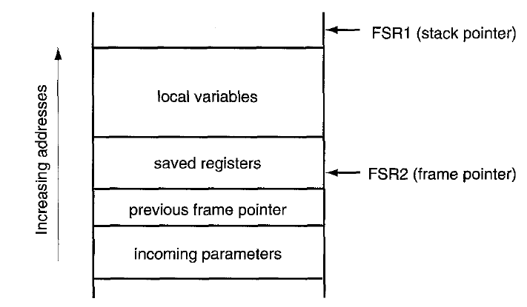
Parameter passing by address and stack
The addresses of the variables are passed in registers. In PIC, the assembly version for this approach is complicated.
In the approach of using stack, once a subroutine is called, the program made reserve a space in the data space for input parameters, local variables, and output parameters. Since the PIC18 uses a hardware stack, the implementation of a software stack in the assembly level is very complicated (For some development kit, the C complier will do it).
The advantage of using stack is For reentrant procedures,
(such as recursion)
f(n)=n!
f(n)=nxf(n-1)

Slide 51
Parameter passing by address and stack
The stack is used heavily during a subroutine call.
The caller may pass parameters to the callee, and the callee may need to save registers and allocate local variables in the stack.
The area in the stack that holds incoming parameters, saved registers, and local variables is referred to as the stack frame.
Some microprocessors have a dedicated register for managing the stack
frame-the register is referred to as the frame pointer.
In PIC18 MCU, the FSR2 register can be used as the frame pointer
The frame pointer is mainly used to reference the location on the stack that separates the stack-based arguments and the stack-based local variables.
Incoming parameters are located at negative offsets from the frame pointer whereas the local variables are located at positive offsets
from the frame pointer.

Slide 52
Parameter passing by address and stack
Immediately on entry to the subroutine, the callee pushes the value of FSR2 onto the stack and copies the value of FSRl to FSR2, thereby saving the caller's frame pointer and initializing the frame pointer for the current subroutine. The callee may save some registers and then add the size of the local variables for the callee to the stack pointer (FSR1).
References to stack-based incoming parameters and stack-based local
variables are resolved according to offsets from the frame pointer.
The reason for having a dedicated frame pointer is due to the fact that the stack pointer may change during the lifetime of a subroutine. Once the stack pointer changes value, there can be problem in accessing the variables stored in the stack frame.

